Slide 1
Software Quality Assurance
Er. Bipin Thapa

Slide 2
Software Requirement Specification
The requirements received from client are written in natural language.
It is the responsibility of system analyst to document the requirements in technical language
so that they can be comprehended and useful by the software development team, QA team and other.
Characteristics of Good Requirements
Complete
Consistent
Feasible
Modifiable
Testable

Slide 3
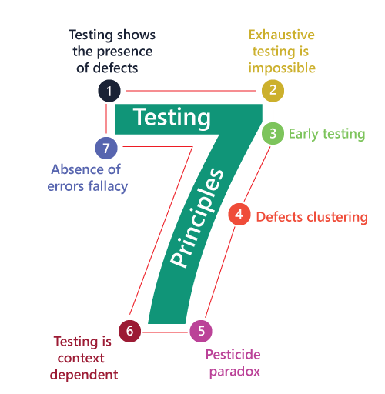
7 Principles of Software Testing

Slide 4
Testing shows presence of defects
S/W testing talks about the presence of defects
Multiple testing can not ensure that the S/W is 100% bug free
S/W Testing reduces the presence of defects.

Slide 5
2. Exhaustive testing is not possible
Testing each and every thing is not possible.
We can only test some test cases and assume that the s/w is correct and works as expected
We need the optimal amount of testing based on the risk assessment of the application.

Slide 6
3. Early testing
The Defect detection in early phases of SDLC will be very less expensive.
Start the testing at the initial possible phase, for better performance/quality of s/w,

Slide 7
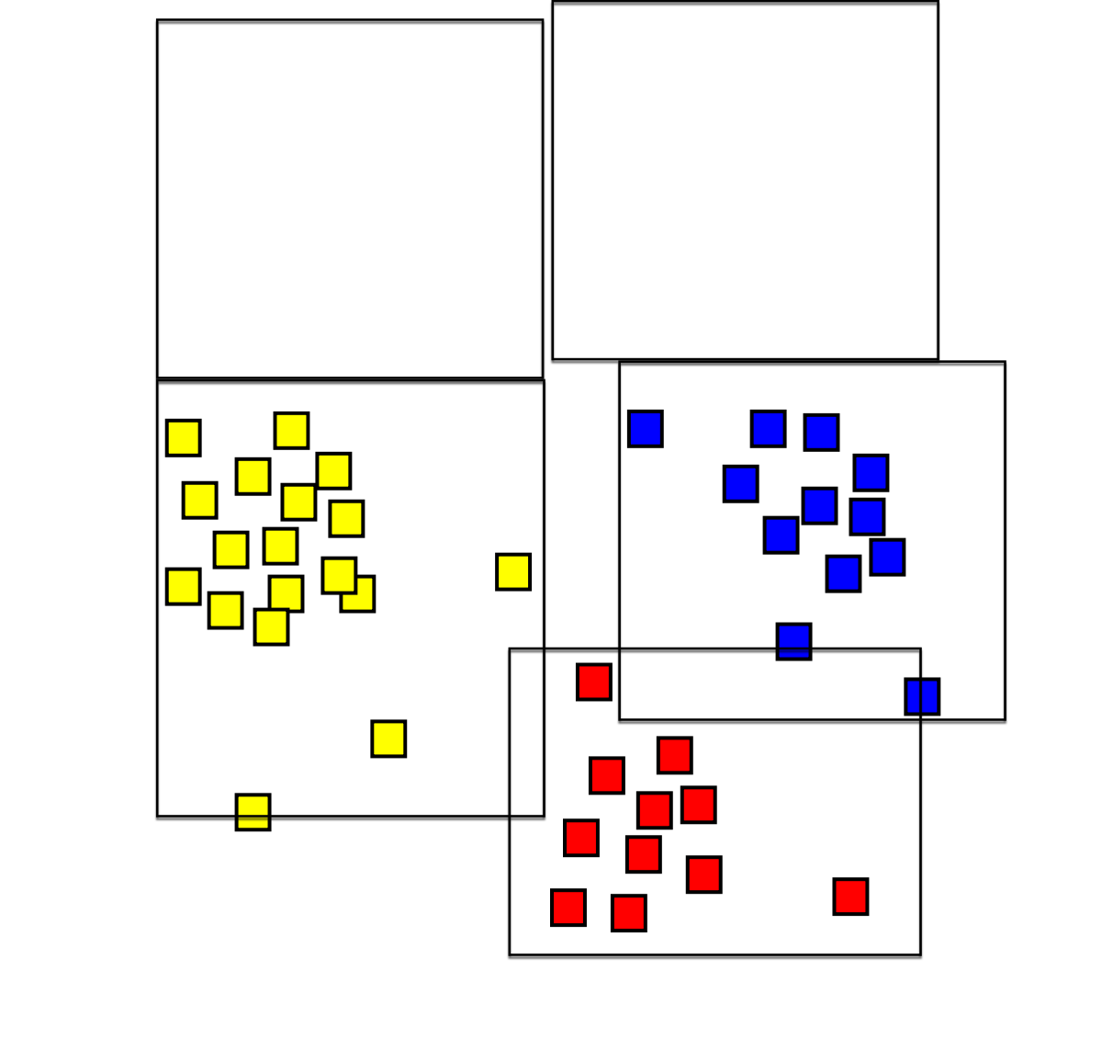
4. Defect clustering
A small number of module can contain most of the defects.

Slide 8
5. Pesticide paradox
Repeating the same test cases again and again will not find new bugs
It is necessary to review the test cases and add/update test cases to find new bugs.

Slide 9
6. Testing is context dependent
Testing approach depend on context of software.
Different type of testing is need for different type of Software.
Eg: The testing of e-commerse site will be different from testing of Android application

Slide 10
7. Absence of errors fallacy
If the build S/W is almost bug free (95%) bug free but it doesnot meet the user requirement then it is unusable.
It is not necessary to be a 95% bug free but instead it is mandatory to fulfill the end user requirements.
Case 1: 95% bug free but it does not fulfil the requirement of client
Case 2: 85% bug free but it fulfil the requirement of client

